Slide 1
DESIGN PATTERNS IN C#
PRESENTER: MOHAMMAD ADIL

Slide 2
DESIGN PATTERNS IN C#
The Design patterns are simply the reusable solutions to the problems which we were facing every day in our programming.
The Design patterns provide general solutions or a flexible and easy way to solve most common design problems.
Design patterns are generally used for solving the problems of of object creation and implementation.
These design patterns are basically treated as templates that can be applied to the real world problems.

Slide 3
DESIGN PATTERNS In SOFTWARE DEVELOPMENT
In Object Oriented Programming, design patterns are simply a reusable solution to common software design problems which occur repeatedly in the real-world software development.

Slide 4
DESIGN PATTERNS IN C#
There are 23 design patterns, also known as Gang of Four (GoF) design patterns.
The Gang of Four is the authors of the book, "Design Patterns: Elements of Reusable Object-Oriented Software".
The book is divide into 2 parts with 1st part is all about advantages and dis-advantages of object oriented programming and 2nd part is about evolution of 23 classic software design patterns.

Slide 5
DESIGN PATTERNS IN C#
After that, design patterns by gang of four has made a great impact in the software development cycle.
These 23 patterns are grouped into three main categories

Slide 6
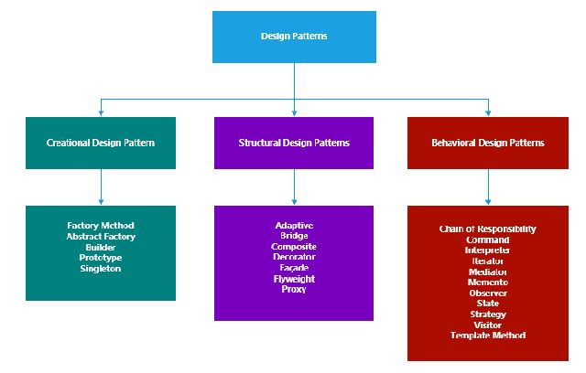
DESIGN PATTERNS IN C#

Slide 7
TYPES OF DESIGN PATTERNS
1. Creational Design Pattern
2. Structural Design Patterns
3. Behavioral Design Patterns

Slide 8
TYPES OF DESIGN PATTERNS
1. Creational Design Pattern
This type of pattern, deals with the generation and initialization of object. By using this pattern program become more flexible in deciding which objects need to be generated for a given task.
2. Structural Design Patterns
This type of pattern, deals with the creation of class and object.
This type of pattern, deals with the interface decoupling and implementation of classes and its objects.

Slide 9
TYPES OF DESIGN PATTERNS
3. Behavioral Design Patterns
This type of pattern, explains the connection between classes and their objects,
This type of pattern, deals with the communication between classes and objects.

Slide 10
1. Creational Design Pattern
Singleton
Factory Method
Abstract Factory
Prototype
Builder

Slide 11
2. Structural Design Patterns
Façade
Decorator
Composite
Adapter
Bridge
Flyweight
Proxy

Slide 12
3. Behavioral Design Patterns
Command
Interpreter
Chain of Responsibility
Iterator
Observer
Mediator
Memento
State
Visitor
Template Method
Strategy

Slide 13
Pre-requisites
Understanding of OOP Concepts like classes and objects, interfaces, abstract classes and 4 pillars of OOP, Inheritance, Polymorphism, Encapsulation and Abstraction.

